Slide 1
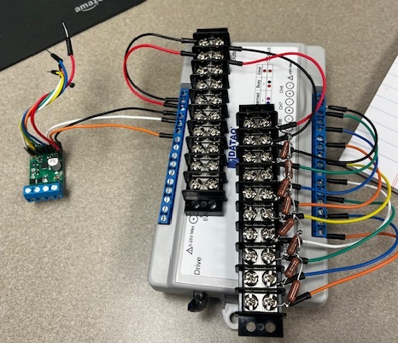
Extra Wires
Sen4 -
Sen3 -
ChB Sen1 -
Sen2 -
Sen4 +
Sen3 +
+
-
6-40Vdc
@ <30A
ChB Sen1 +
Sen2 +
PWM Drive
To PUMP
- +
ChA Sen1

